Slide 1
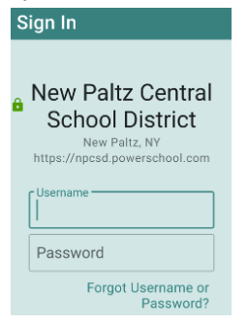
PowerSchool Parent Portal
for students and parents
https://npcsd.powerschool.com
Cheri Pettus, parent portal coordinator
cpettus@newpaltz.k12.ny.us
845-256-4060

Slide 2
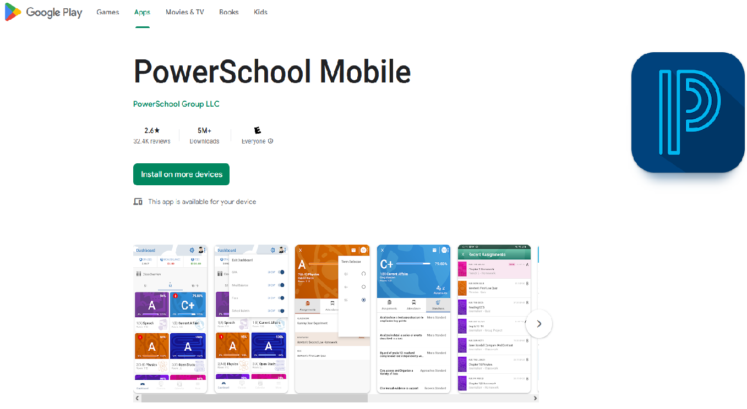

Slide 3
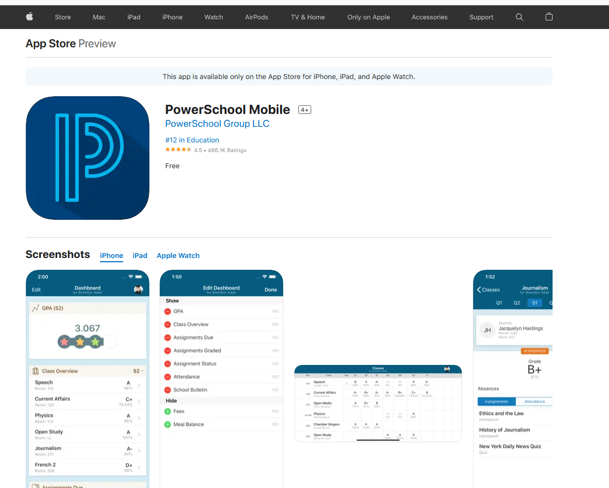

Slide 4
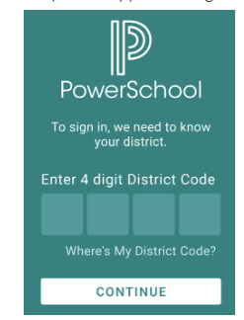
R G M J

Slide 5
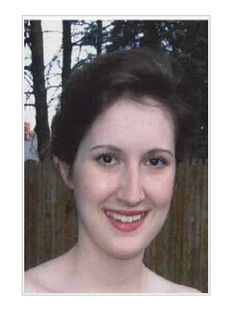
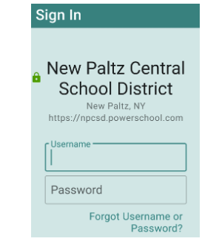
STUDENTS log into the parent portal with their computer username and password
Student example:
Username = JDoe
Password = 12864

Slide 6
PARENTS need to create an account
Email or call Cheri Pettus at cpettus@newpaltz.k12.ny.us
845-256-4060

Slide 7
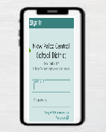
Parent Portal – 2 ways
https://npcsd.powerschool.com
PowerSchool Mobile app (Google Play or iTunes store)

Slide 8
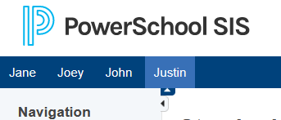
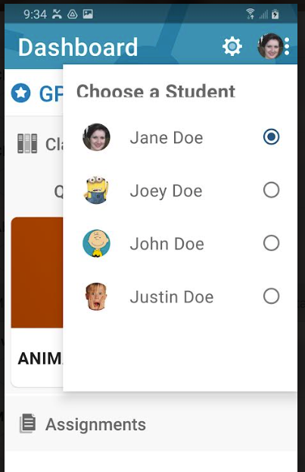
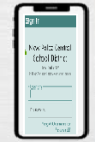
One account – several children

Slide 9
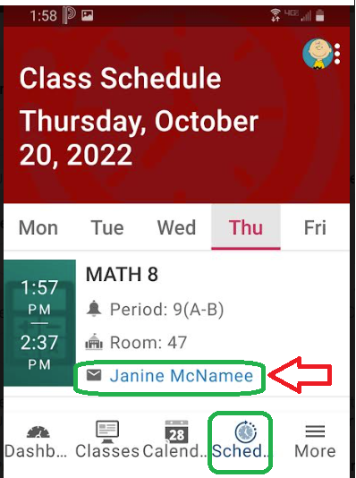
Email your child’s teacher

Slide 10
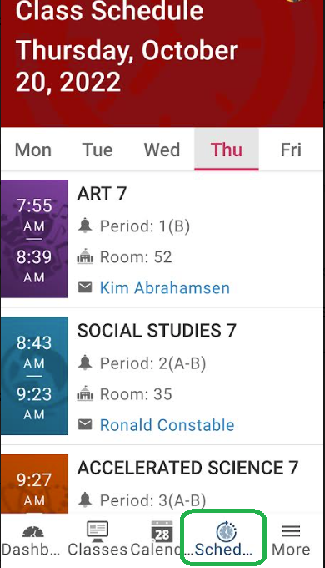
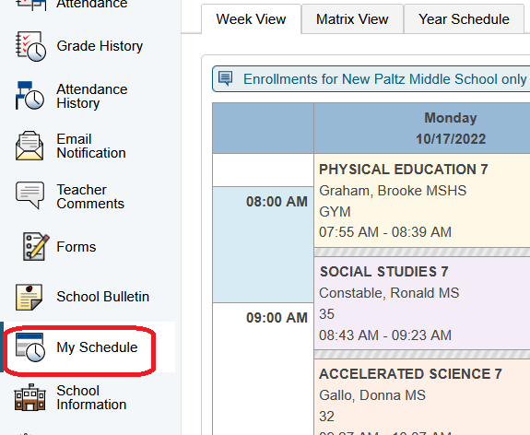
SCHEDULE

Slide 11
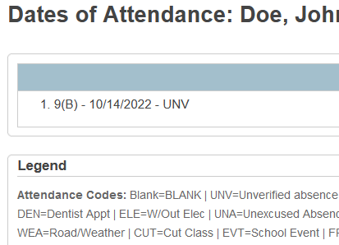
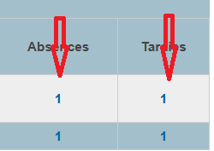
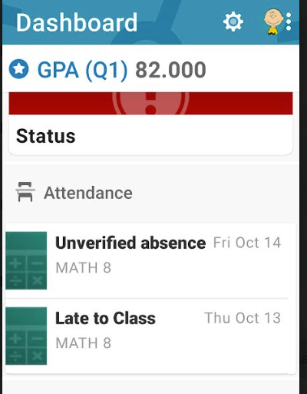
ATTENDANCE

Slide 12
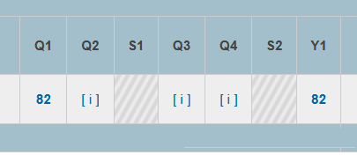
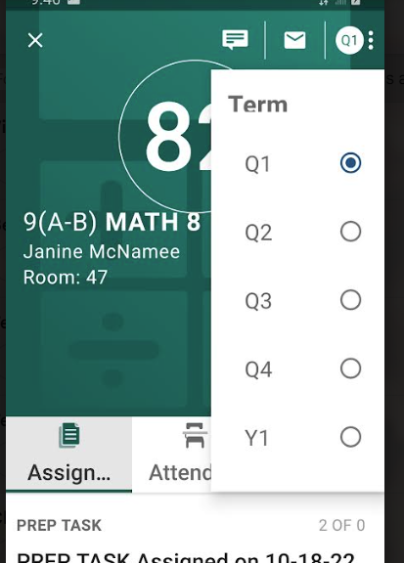
Parent Portal - “Terms”
MIDDLE SCHOOL AND HIGH SCHOOL:
Q1 = Quarter 1
Q2 = Quarter 2
S1 = Semester 1
Q3 = Quarter 3
Q4 = Quarter 4
S2 = Semester 2
Y1 = Year
M1 = Midterm exam
F1 or F2 = Final exam
R2 = Regents exam
We give report cards every 5 weeks. Assignments are in the parent portal.

Slide 13
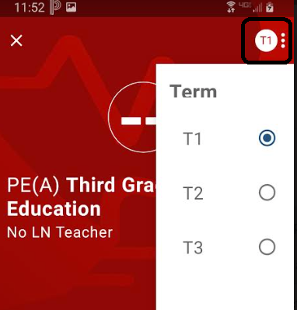
Parent Portal - “Terms”
DUZINE AND LENAPE:
T1 = Trimester 1 (September – November)
T2 = Trimester 2 (December – March)
T3 = Trimester 3 (April – June)
We give report cards 3 times a year (December, March, and June).

Slide 14
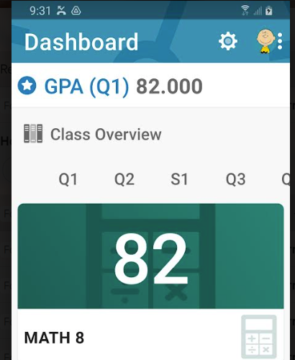
Middle and High School: GRADES
Click on the number to view the assignments

Slide 15
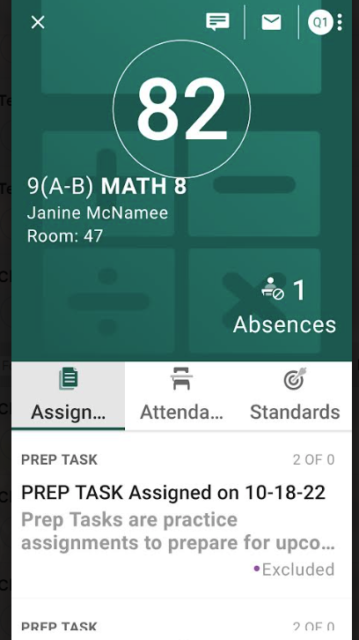
Middle and High School ASSIGNMENTS

Slide 16
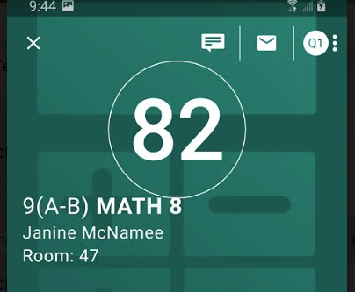
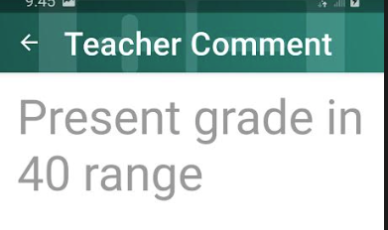
Middle and High School COMMENTS

Slide 17
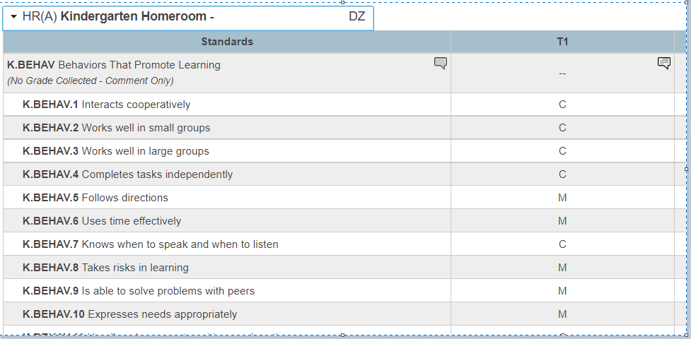
Duzine and Lenape STANDARDS
C = Consistently
M = Most of the time
S = Some of the time
R = Rarely
NY = Not yet
NA = Not applicable at this time

Slide 18
Duzine and Lenape STANDARDS

Slide 19
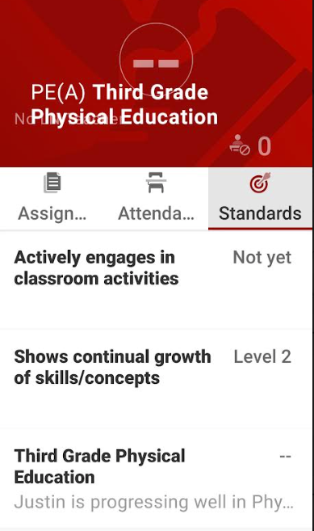
Duzine and Lenape STANDARDS

Slide 20
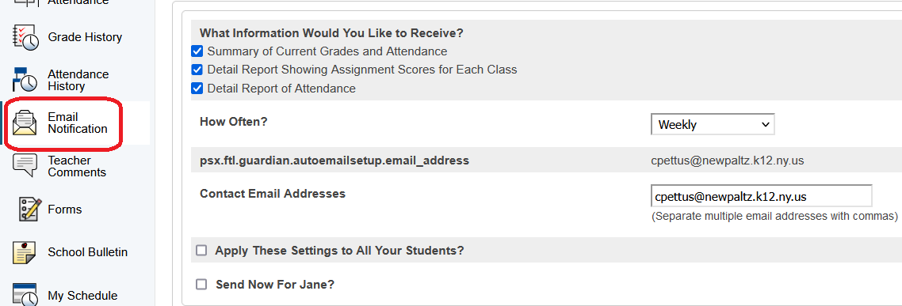
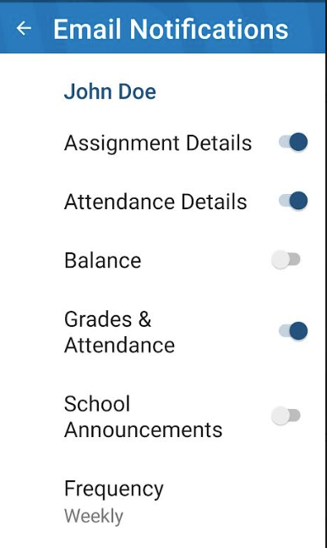
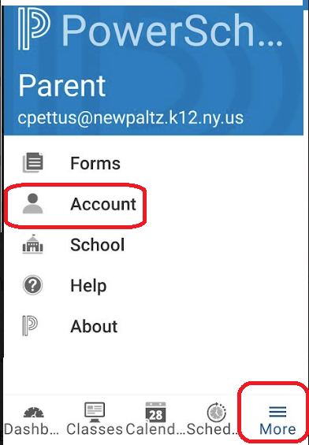
Set up automatic Email Notifications

Slide 21
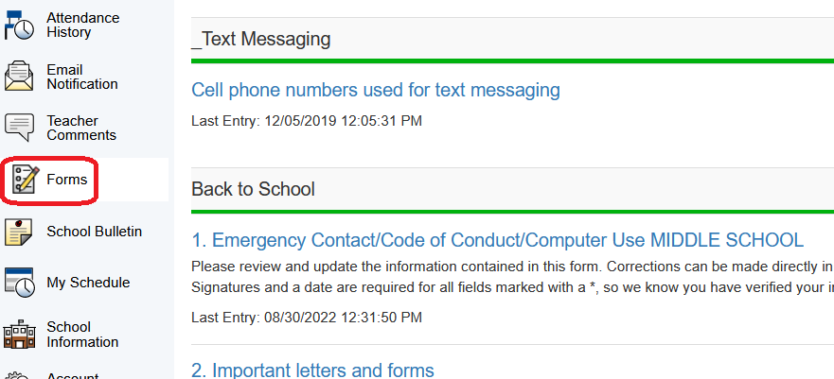
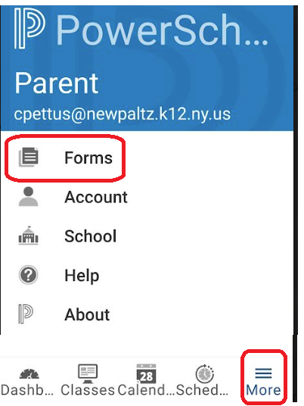
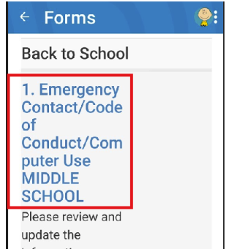
Fill out School Forms

Slide 22
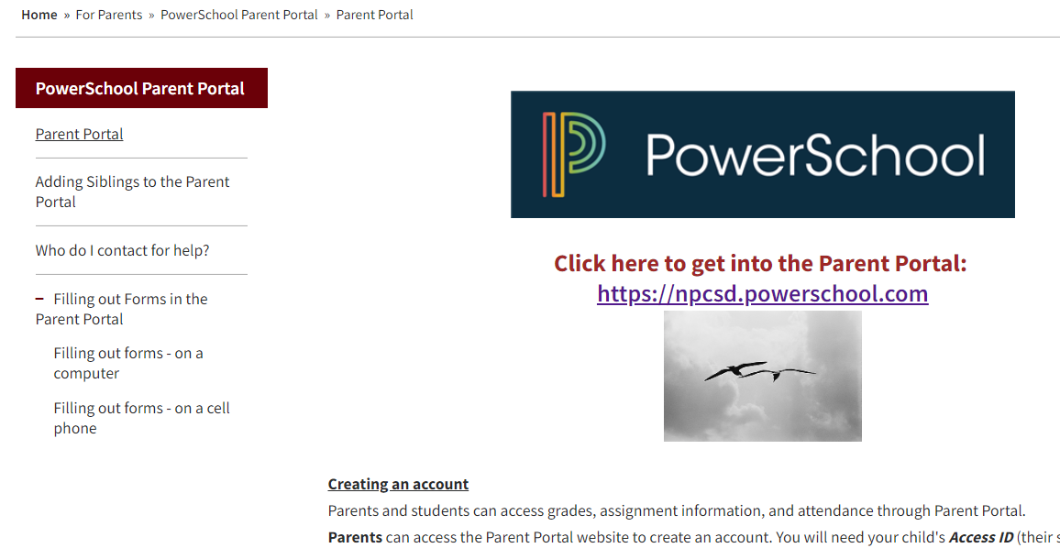
Need more help? https://www.newpaltz.k12.ny.us/portalhelp

